Slide 1
B&NES Council | Citizens’ Panel on Active Travel in Bath and North East Somerset
Full report | October 2022

Slide 2
Contents
1
Introduction & key findings
5
Residents’ views on active travel in Claverton Down
2
Residents’ views on travel and transport in BANES
6
Residents’ principles for active travel schemes in BANES
3
Residents’ views on active travel
7
Conclusions and recommendations
4
Residents’ views on encouraging active travel in BANES

Slide 3
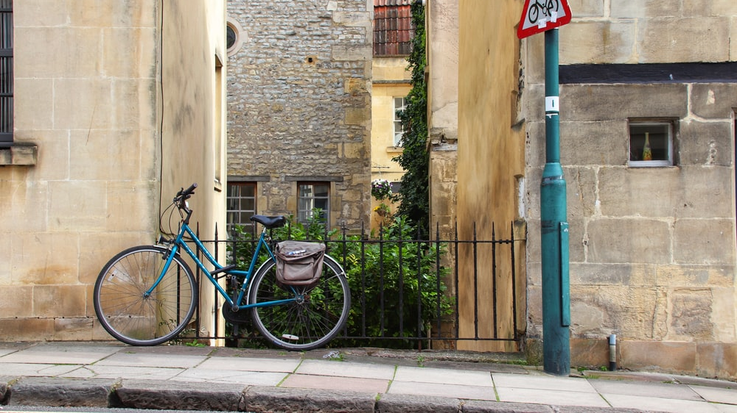
3. Residents’ views on active travel

Slide 4
Active travel is less top-of-mind than other forms of transport, but most participants do it at least some of the time
People who walk/cycle frequently…
People who walk and cycle sometimes…
People who do little / no active travel…
Typically:
Don’t own a vehicle (and it is worth noting in our sample this skewed towards those on lower incomes)
Are living in / near the city centre.
Are students and young people.
See it more as a leisure activity that you do for pleasure rather than function to get from A to B e.g. they might only cycle when on holiday.
Are more likely to walk than cycle if they do do it.
Are more likely to use it for a short journey.
Have mobility issues or disabilities that prevent them form doing so.
Are unfit / have low confidence riding a bike.
Have small children.
Don’t own a bike and consider it prohibitively expensive to buy one.
Live further away from the city centre or not in the city at all.
“I used to use the canal system a lot to get around Bath, whether walking or as a cyclist. Even as a mother with small children I still found it to be a great way to get around, get to see the gardens, get to town, get to work quite often… [now] I've got chronic conditions unlikely to improve so I don’t cycle anymore.”
Infrequent active traveller, 18-34

Slide 5
Residents who already walk and cycle as part of their routines are sold on the benefits
Convenient
A way to enjoy the area
Fitness and wellbeing
Low cost / free
It can make a more flexible journey, with participants able to bypass some common transport challenges by dodging congestion and avoiding public transport delays.
On a day with good weather, it can be much more pleasant than being stuck in a vehicle, especially with the beautiful natural scenery in the local area.
Active travel incorporates regular exercise into a daily routine and feeling physically healthier.
It is key for mental health, with scenery making it a particularly pleasant place to walk / cycle through.
No cost per journey
Not a key reason for anyone, but certainly a bonus
“It’s a lovely walk and you can often beat the bus as well.”
Frequent active traveller, 18-34
“Usually I walk into town because I live at the top of a hill and it’s a beautiful walk […] I’m quite active so I enjoy the walk.”
Frequent active traveller, 55+
“I tend to do more walking than anything else. It's convenient, it's healthy, it doesn’t require any specialist knowledge or transport needs and you can do things in your own time, it can be quite relaxing.”
Frequent active traveller, 55+

Slide 6
But strong barriers to active travel prevent people making the switch and changing their routines
Inconvenient
Physically hard
Unpleasant environment
Unsafe
Expensive outlay
Take longer and required more effort.
Especially when travelling in a group, travelling to / for work, or carrying a load (e.g. when shopping).
Not possible for disabled people.
Really hard for those not used to physical activity, especially given the hilly terrain.
Congestion in busy parts of the city causes noise and air pollution.
Bad weather puts people off.
Cars leaving little space for cyclists and being a danger to pedestrians.
Steep hills that make it hard to control speed.
Poor road conditions.
Walking in unlit areas at night.
Initial cost of a bike, especially an e-bike or e-scooters, is felt to be prohibitive.
“Going to Lidl is a common journey. I’m obliged to go by car — I have an e-bike but that’s no good for shopping.”
Frequent active traveller, 55+
“You're not going to be cycling in heavy traffic because you'd be inhaling all those fumes."
Infrequent active traveller, 55+
“It’s very car heavy, at times dangerous and air pollution is a real concern for me with children. My children’s school is right next to Lansdowne Lane, very busy all the time, fatal accident not too long ago due to traffic [...] Physical safety and air pollution are concerns for me.”
Frequent active traveller, 35-54
“The cost of buying an e-bike is prohibitive. I'm not unfit but no way could I tackle nearly all of the hills in Bath on a [normal] bike.”
Frequent active traveller, 35-54

Slide 7
Quotes on the barriers to active travel
“I have meetings to do at work and notebooks to bring. Even as a young, fit, healthy person I don't like the idea of carrying that stuff up and down the hill every day.”
Frequent active traveller, 35-54
“In a busy city it makes me quite anxious cycling in the traffic and in the dark it might be much worse.”
Frequent active traveller, 55+
“In the west country the weather isn’t great, and I think people jump into their car at the first opportunity. I don’t think there are many people that would be willing to jump on their bike and cycle up in awful weather in the darkness in the winter."
Infrequent active traveller, 35-54

Slide 8
These are two case studies of residents in our sample to bring to life the barriers to active travel in BANES:
Jennifer, 46
Samuel, 57
Owns a car but rarely uses it, walking almost everywhere locally and taking the direct bus route from her home to the city centre if needed.
Views active travel positively and feels walking is a good way to de-stress, with nice views to enjoy, and does not cause pollution.
Almost never cycles as the road condition is too poor, and potholes make cycling feel unsafe. Also notes that bikes are no longer available to rent.
Thinks repairs should be made to roads to make journeys safer, with a more regular bus service uphill.
Reliant on a car due to health issues, walks for leisure, but cannot use the bus due to long waiting times.
Views active travel very positively, and used to try to walk everywhere when he was able to, but due to his physical condition is unable to rely solely on active travel.
Concerned that any schemes might prevent disabled participants from getting around by closing key roads.
However, less cars on the road would make his journeys faster and less congested.
Thinks the transport system should be more cohesive, making it easier for people to cycle and take a bus on the same route, with more reliable public transport, or a dial-and-ride scheme for those unable to walk / cycle.
“There are big chunks of Bath where it [active travel] could be done. There are flat bits, there's the whole area around CD where they don't really have to tackle hills.”
”These things shouldn’t and can’t be separate, you often need to go from your bike to bus or train […] it's so hard to mix and match. You have to commit, either walk or cycle or public transport. No flexibility there.”
*Names have been changed.

