Slide 1

B&NES Council | Citizens’ Panel on Active Travel in Bath and North East Somerset
Full report | October 2022

Slide 2
Contents
1
Introduction & key findings
5
Residents’ views on active travel in Claverton Down
2
Residents’ views on travel and transport in BANES
6
Residents’ principles for active travel schemes in BANES
3
Residents’ views on active travel
7
Conclusions and recommendations
4
Residents’ views on encouraging active travel in BANES

Slide 3
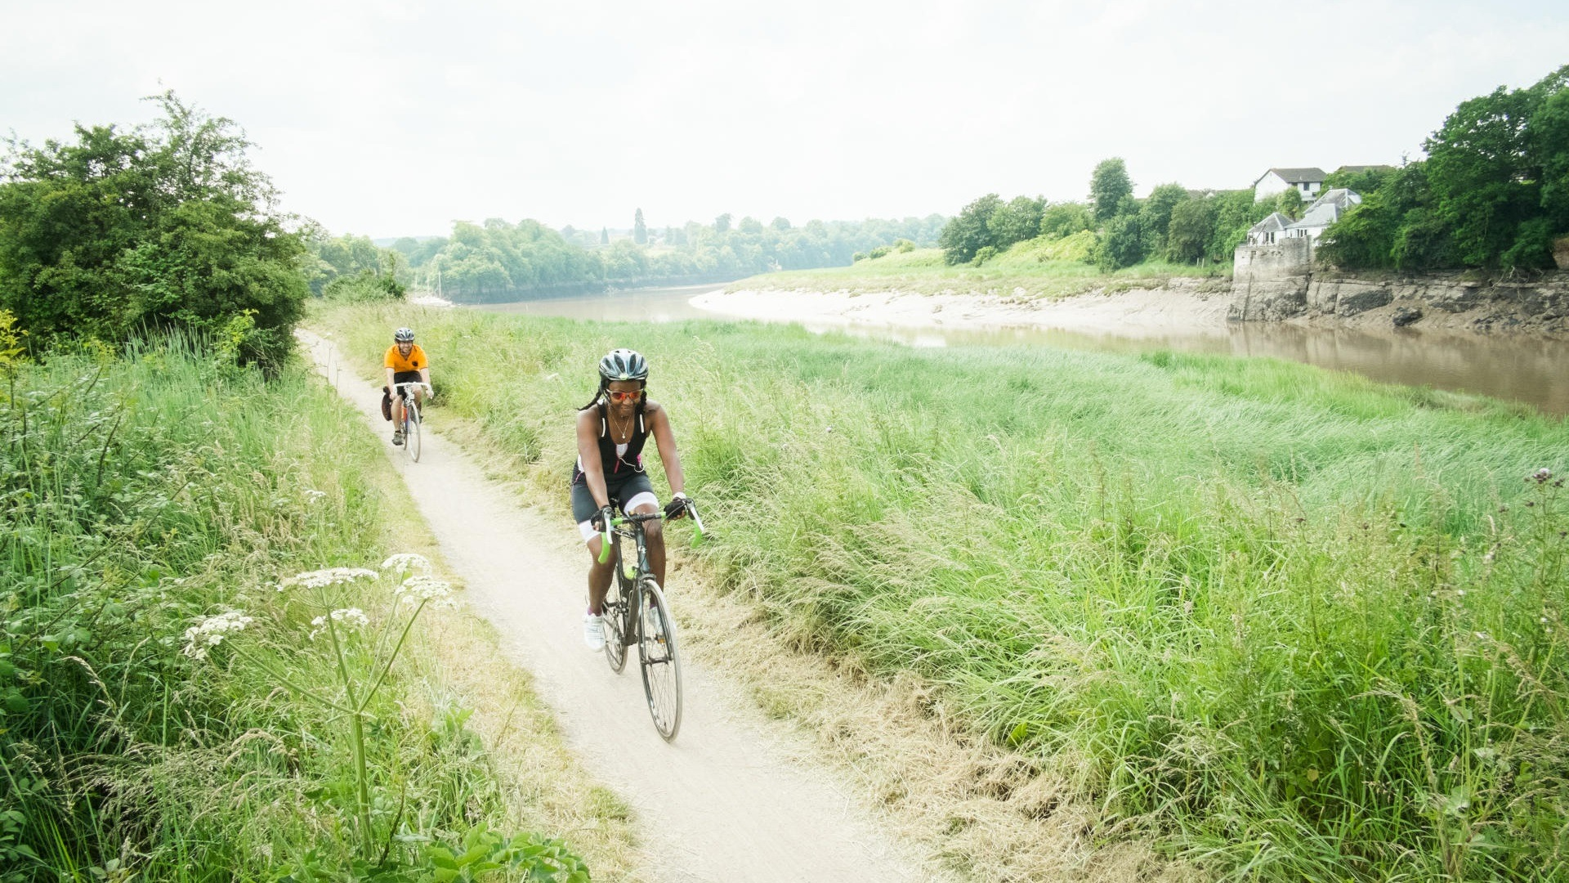
Residents’ views on encouraging active travel in BANES

Slide 4
The need to consider changes to travel and transport in order to reduce to CO₂ emissions is spontaneously recognised
The need to reduce CO₂ emissions in the UK was spontaneously mentioned and well understood.
  The contribution that transport, especially car use makes to emissions was also well known.
Many participants said they were minimising car use where possible by walking or taking the bus for short distances, combining journeys into a single trip, or offering car / taxi shares to those travelling in the same direction.
“If you could encourage more people to walk, I understand it's not possible for everyone, but it would be good for the environment and reduce carbon emissions.”
Frequent active traveller, 18-34
“I try to offer lifts to people, if I’m going further afield. If I’m getting a taxi from the train centre to the retreat centre I will always offer to do taxi shares etc.”
Infrequent active traveller, 55+

Slide 5
When prompted, the role of active transport in reducing CO₂ emissions is accepted and increasing its take-up is supported
When presented with a list of issues, reducing carbon emissions was selected as a number one priority more frequently than any other issue.
And after digesting the information on the online community, residents were supportive of efforts by the Council to drive up its use.
Q. In your opinion, what should the top three priorities be for Bath and North East Somerset Council? All respondents (n=27)
Q. Having seen this information, how supportive do you feel about the Council encouraging active travel in the Bath and North East Somerset area? All respondents (n=27)

Slide 6

But despite support for CO₂ reduction, it’s the personal benefits/drawbacks that have the most impact on modal choice
When we ask residents about the reasons why they choose to travel by car instead of by foot/bike:
They talk about the personal benefits of car use …
…and the personal drawbacks of active travel
Convenient – door to door
Weather-proof
Can easily combine journeys e.g. pick up kids on way back from work
No planning required
Can transport children and luggage
Physically easy
Feels comfortable and safe
The norm
Takes longer
Physically difficult or not possible
Difficult with children/luggage
Scary / unsafe
Uncomfortable
Different to normal routine

Slide 7

Therefore, personal mental and physical health benefits are the most effective inducement to active travel
E.g.: ‘I would consider actively travelling more often, because I think it would make me fitter and healthier, both physically and mentally'
This is felt to be the most motivating reason, because it is a personal benefit.
Many residents felt active travel could help them get fitter and healthier.
Dr Ian Walker’s point that active travel is a way to exercise without taking time out of your day for exercise resonated well.
The mental health benefits were seen as even more important post-pandemic lockdowns.
    It is important to know that this argument did not resonate personally for residents with mobility issues. They feel walking or cycling to not be an option for them, and so would not have a beneficial affect on their physical or mental health.
“Exercise is good for your mental health as well as your physical.”
Frequent active traveller, 55+
“I particularly agree that for most people expecting them to find dedicated time for exercise, to make the effort to go to the gym or even go for a jog, is not going to happen and that we need to encourage people to be more active in their day to day lives.”
Infrequent active traveller, 55+

Slide 8
For similar reasons, reducing air pollution in Bath was seen as a motivating factor for active travel
E.g.: ‘With fewer cars on the road emitting pollution, the roads would be a nicer place to walk and cycle around, and the city a better place to live.’
Discussing the environment in terms of tangible and local impacts was more motivating than bigger picture framing around climate change.
Local residents liked that fewer cars on the road would mean less air pollution and nicer local environment.
“I would love for there to be less air pollution and cleaner air. Would make walking around the city much nicer”
Infrequent active traveller, 35 - 54
"In the height of the pandemic when there was less cars on the roads, I was struck by how clear the sky was. Air pollution is probably slowly killing all of us.”
Infrequent active traveller, 55+

Slide 9
Investing in active travel infrastructure and reducing vehicles on the road was seen to make active travel more attractive
E.g.: ‘Bath is so congested with traffic, more people cycling or walking those shorter journeys would reduce that significantly, and make getting around Bath much easier’
Residents felt more active travel would reduce the levels of congestion in the city, if people swapped their cars for walking/cycling. As congestion was such as big issue for them, this was a strong argument to encourage people to actively travel more.
Residents feel that fewer cars on the road means the safer, healthier and more enjoyable it will become to actively travel around the city.
    There were some who felt that more active travel would make it easier for them to travel around by car, rather than encouraging them out of their cars.
    There are those who feel that even if there was better active travel infrastructure then they would not feel able to take up active travel due to mobility issues.
“The area I live in is very congested with traffic. It would be great if something like this could take some of those cars off the road”
Frequent active traveller, 35-45
“We have all just gotten so used to cars, I think the less we use cars and the less we are stuck in traffic the better”
Frequent active traveller, 18-34

Slide 10
Views on active travel infrastructure

Slide 11





Residents’ own ideas for improving active travel infrastructure were about making active travel easier and safer
“Wider pavements and cycle lanes would make it much more pleasant and feel safer for pedestrians and cyclists.”
Infrequent active traveller, 35-54
Provide more space for cyclists via cycle lanes or one-way routes to make cyclists feel safer.
Remove / limit street parking to widen roads and reduce driving to make cyclists feel safer.
“Maybe a shuttle that goes up and down the hill to ferry walkers, and prams or people with bikes up and down the hill.”
Infrequent active traveller, 55+
Offer shuttle buses with bike racks for those who prefer not to cycle uphill, but would cycle down if they could transport their cycles.
Ensure there are ramps alongside any stairs for cyclists who choose to walk uphill and cycle down.
Make e-bikes and e-scooters more readily available for all through rental or trial schemes, especially near hills.

Slide 12
Improving bicycle parking facilities is the most popular intervention, as long as accessibility concerns are dealt with
We presented participants with the planned addition of bike parking stands and lockers on the Upper Bristol Road, as an example of how improved bike parking facilities could be implemented in Bath.
Benefits
Concerns
Safe and secure bike storage will encourage more people to take up cycling, and normalise cycling in the city.
This will also make it much easier for people to start cycling as part of their everyday journeys, like commuting.
Several note that this sort of scheme would be very useful for students, who often live in cramped houses with little space for a bike.
Bike lockers could further narrow pavements, which could have a significant impact wheelchair users.
If parking were to be removed to make space, this would make it more difficult for drivers to park close to their destination, which is especially crucial for disabled drivers.
Fee to use the bike lockers would make it difficult for some to access e.g. students.
“If your bike is safe, then more people would invest in bikes.”
Infrequent active traveller, 35-54
“Would be a potential conflict if cycle parking furniture and parked cycles spilling out into pavement space needed for pedestrians and wheelchair users.”
Infrequent active traveller, 35-54

Slide 13
Introducing better pedestrian crossings is popular, but some are concerned it could increase congestion
We presented participants with different examples of pedestrian crossings that could be implemented, such as continuous footways on Upper Bristol Road, a new parallel crossing at Nile Street Junction, or widening pathways at crossing points. These were all examples of how new pedestrian crossings could be implemented in BANES.
Benefits
Concerns
Walking is more appealing as it feels safer, especially for children.
Helps to clarify pedestrian prioritisation on the roads.
Potential to increase congestion with drivers finding it more difficult to pull off turnings.
It won’t make busy roads any more appealing to walk on, as they would continue to be noisy and polluted.
“Encourages more walking, safer crossings might slow traffic and make walkers feel safer.”
Frequent active traveller, 55+
“Personally I don't see this working at peak hours as a motorist could probably sit there indefinitely waiting for someone to let them out, worse still if they are turning right out of the side street.”
Infrequent active traveller, 55+

Slide 14
In principle, cycles lanes are felt to be a valuable change, but there are concerns about implementation
We presented participants with the planned implementation of a cycle path on Beckford Road as an example of how cycle lanes could be implemented in BANES.
Benefits
Concerns
The majority feel that if cycle lanes were built, it would encourage more people to take up cycling as a key mode of transport for them as it would feel safer (although most feel this is only if the cycle lanes are segregated and continuous).
Residents are especially keen on the idea of more bikes and less cars on the roads as it would mean less pollution, cleaner air and a healthier Bath and North East Somerset.
Some are unsure that cycle lanes would be widely used, and say they needed to see more evidence of the demand.
Some feel it is impractical or dangerous to put in a cycle lane on local narrow roads.
The removal of parking spaces in favour of cycle lanes may negatively impact residents who want to park their cars locally and those who need to drive (e.g. people with mobility issues).
“they enable cyclists to avoid being caught up in congestion… so a cycle lane would give me confidence to cycle more”
Infrequent active traveller, 35-54
“They require a lot of extra road and in Bath we tend to have quite small roads that make this hard to achieve”
Frequent active traveller, 18-34

Slide 15
Proposals to remove on street parking are the most contentious, but many feel it is necessary to enable change
We presented participants with the planned moving of on-street parking on Beckford Road and Forester Road in order to make space for a cycle path.
Benefits
Concerns
Less parking along busy roads would likely reduce congestion, making traffic flows in the local area smoother.
This would be likely to encourage more people to actively travel for shorter journeys.
Safer for cyclists and pedestrians, with clearer visibility.
Would unfairly penalise local residents if it prevented them from being able to park near their homes.
Would also disproportionately impact on people with that rely on cars as they cannot travel actively.
Could negatively impact visitors to the city, as residents feel this group is more likely to drive in to the Bath city centre and require parking.
“More space for cleaner and healthier travel.”
Frequent active traveller, 35-54
“The issues will be that, less parking spaces will be difficult for residents and for visitors to Bath. It also alienates residents and makes them less receptive to change. ”
Infrequent active traveller, 55+

Slide 16


After considering all the potential infrastructure changes, residents are still left with some concerns…
Safety
Accessibility
Residents express feeling unsure as to whether active travel infrastructure will make the local area any safer, as currently it doesn’t feel particularly safe:
Roads currently are very narrow and busy, which makes residents feel these are unsafe to actively travel along. Many residents struggle to see how active travel schemes could be implemented on these roads.
Residents raise concerns that the cycle lanes already in place are just lines painted on the road, and so do not feel well protected from traffic.
Residents are concerned about how universally accessible active travel schemes could be:
Residents raise concerns around how many people will feel that they are able to travel actively (e.g. they will feel fit or mobile enough.
There were concerns as to how accessible active travel schemes would be in an area like BANES due to topography and narrow roads.
Residents wanted reassurance those with mobility issues who are unable to actively travel would be considered and aren’t disadvantaged (e.g. more congestion and less parking making their journeys harder).
“You would have to make sure this is all safe. Otherwise people just won’t do any of it”
Infrequent active traveller, 35-54
“When this is being planned we need to start with the disabled people, make it work for them first, and I'm not sure we're doing that at the moment.”
Frequent active traveller, 55+

