Slide 1

B&NES Council | Citizens’ Panel on Active Travel in Bath and North East Somerset
Full report | October 2022

Slide 2
Appendix 4

Slide 3


We asked participants to draw conclusions about the local impact of active travel schemes and develop principles to guide implementation
4. Final deliberative session or in-depth interview
All main strand participants, Zoom session with breakout groups (120 mins)
3 hard-to-reach strand participants, individual Zoom or phone calls (60 mins)
Introductions
We introduced the terms of the session
Participants introduced themselves
Reflecting on the learning platform
We asked participants about the arguments they’d engaged with on the learning platform and their thoughts on the active travel schemes they’d learnt about.
Local impact of active travel schemes
We showed participants evidence from a local cyclist and asked participants to consider the impact of cycling-related active travel schemes on cyclists and other people living, working and travelling in the area.
We showed video testimony from 3 local residents’ association members (Mark Hynes, Chair of North Road Residents’ Association and Jeremy Boss, Chair of Widcombe Hill Residents’ Association and a third person who has not consented to have their name shared publicly) to help our participants consider the impact of active travel schemes on people who live nearby to them. The testimonies were related to any proposed active travel schemes the local residents had heard of, rather than focusing on specific routes.
Developing principles
We asked participants to come up with a set of overall principles the Council should consider when implementing active travel schemes in the local area.
In the interviews with the hard-to-reach participants, we covered the same topics

Slide 4
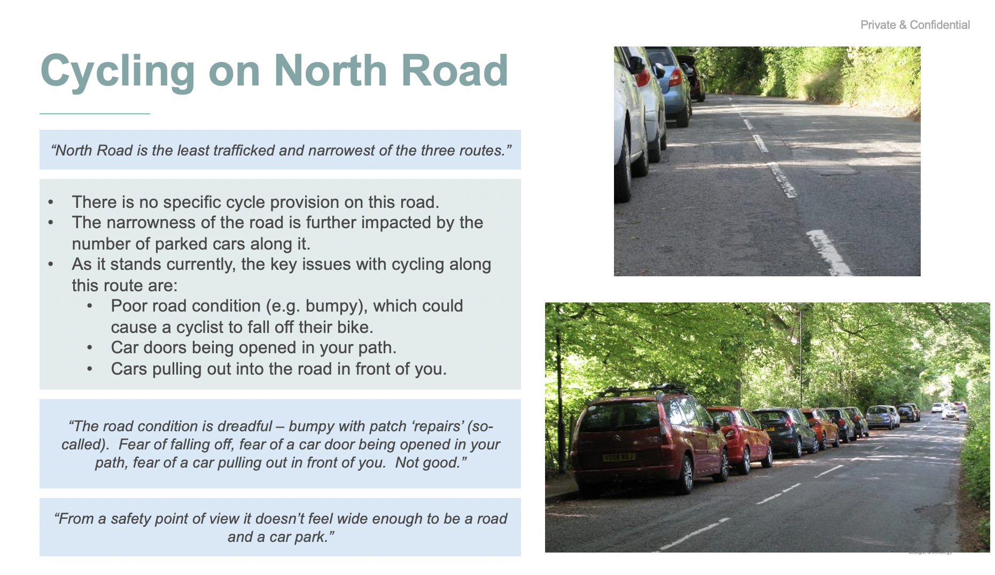
This is the evidence from a local cyclist who works in the area on what it is like to cycle around Bath (1/4)
4. Final deliberative session or in-depth interview

Slide 5
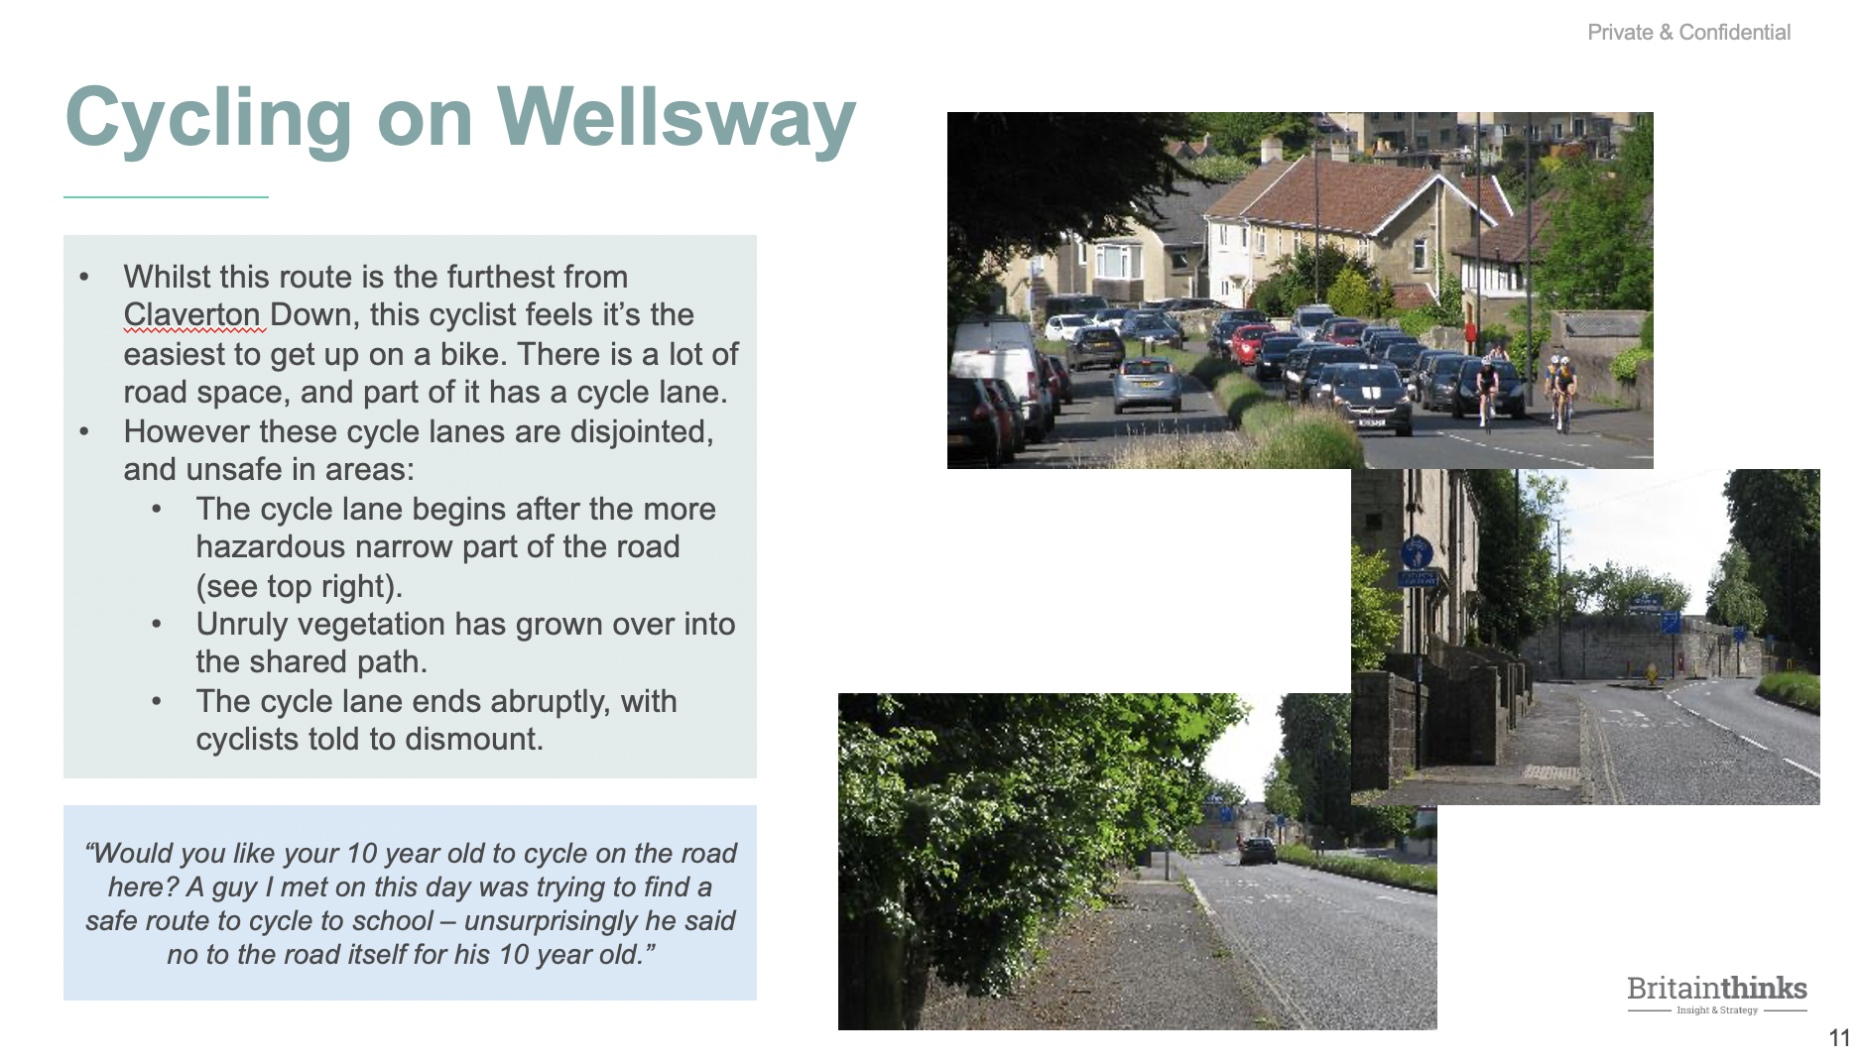
This is the evidence from a local cyclist who works in the area on what it is like to cycle around Bath (2/4)
4. Final deliberative session or in-depth interview

Slide 6
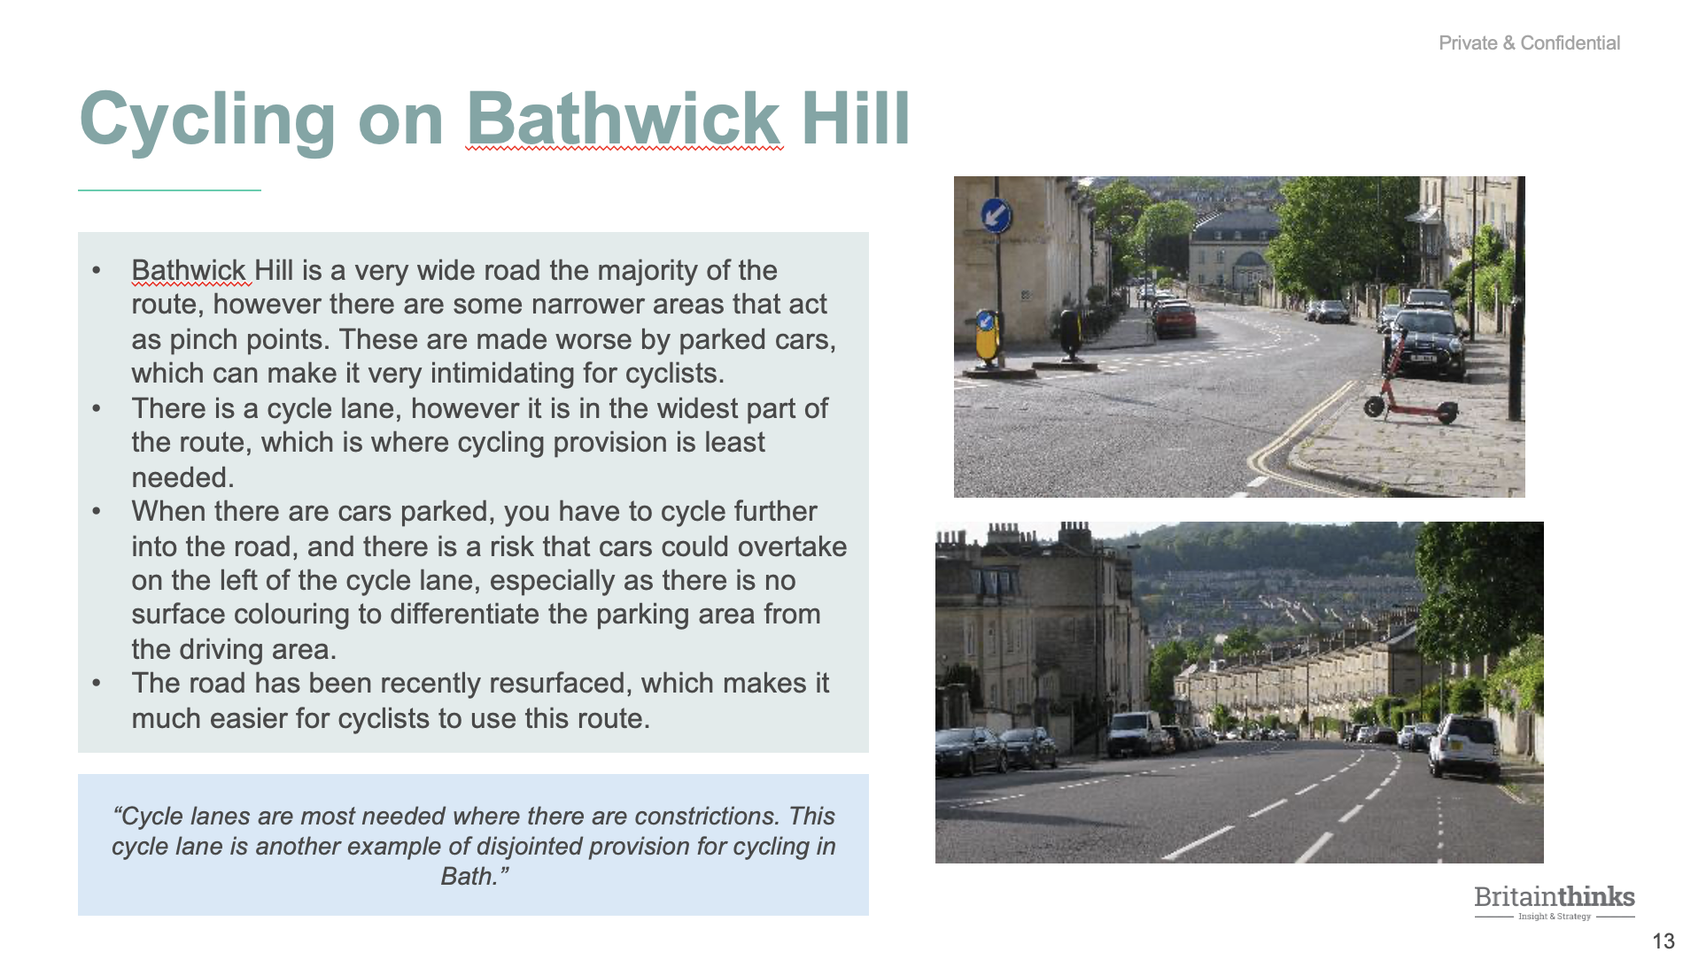
This is the evidence from a local cyclist who works in the area on what it is like to cycle around Bath (3/4)
4. Final deliberative session or in-depth interview

Slide 7
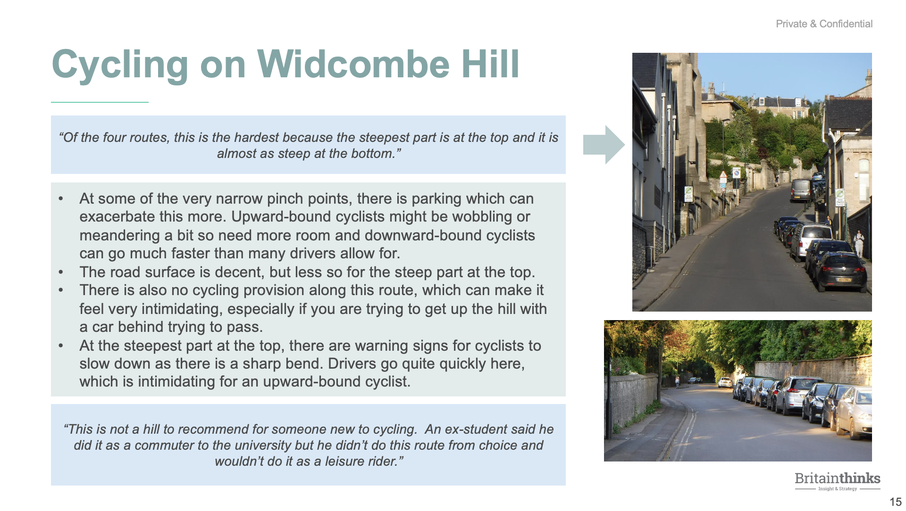
This is the evidence from a local cyclist who works in the area on what it is like to cycle around Bath (4/4)
4. Final deliberative session or in-depth interview

Slide 8
Thank you
Lucy Bush
lbush@britainthinks.com
T: +44 (0)20 7845 5880
www.britainthinks.com
BritainThinks
West Wing
Somerset House
London
WC2R 1LA
United Kingdom

