Slide 1
Bath City Centre Security
Informal Cabinet
Monday 20 January 2020

Slide 2
The Current Threat
Level of Police and Security Service activity
↑ High
700+
Live Investigations
Cooperation between the public and police is a key element in tackling the threat of terrorism in the UK
20,000
Individuals of
continuing
concern
>3,000
Individuals
Involved
Extreme Right Wing motivated attacks stopped since March 2017
Islamist extremist related attacks stopped since March 2017
16
8
Notes:
***OPTIONAL SLIDE***
Official figures released by Counter Terrorism Policing HQ – June 2019.
Key points to highlight are be the large number of individuals involved, and the increasing proportion of right wing attack plots that have been disrupted.

Slide 3
National and Local Context
CONTEST
Since June 2003, the UK government has had a long-term strategy for countering terrorism known as CONTEST. The aim of CONTEST ‘is to reduce the risk from terrorism, in its different forms, so that people can go about their daily lives, freely and with confidence’.
The strategy is divided into four parts: ‘Prevent’, ‘Pursue’, ‘Protect’ and ‘Prepare’. The ACT Strategic event focuses on the ‘Protect’ and ‘Prepare’ strands of the CONTEST strategy which look to reduce vulnerability:
Protect: the purpose of protect is to strengthen our protection against a terrorist attack by increasing the resilience of the UK’s infrastructure and improving protective security for crowded places
Prepare: the prepare strand is concerned with ensuring that the UK is as ready as it can be for the consequences of a terrorist attack. The key elements are; identifying the potential risks the UK faces from terrorism and assessing the impact, building the necessary capabilities to respond to attacks and continually evaluating and testing preparedness

Slide 4
Threat Levels
Critical
An attack is highly likely in the near future
Severe
An attack is highly likely
Substantial
An attack is likely
Moderate
An attack is possible but not likely
Low
An attack is highly unlikely
What is the current national threat level in the UK?
Notes:
***COMPULSORY SLIDE***
KEY POINTS:
The UK threat level structure was revised in July 2019.
There are no longer separate threat levels for “international terrorism” and Northern Ireland-related terrorism in the UK. There is now just one National Threat level which reflects all aspects of terrorism regardless of the motivation, including Islamist, Northern Ireland, left-wing and right-wing terrorism.
The threat from Northern Ireland related terrorism in Northern Ireland will remain separate from the national threat level.
The threat level was last raised to CRITICAL in 2017 - Manchester Arena in May & Parsons Green in September.
The previous 2 occasions that the threat was raised to CRITICAL were The Tiger Tiger nightclub/Glasgow Airport attacks in 2007 & following the arrest of 21 people in relation to the airliner bomb plot in 2006.
Discuss with your audience why the threat level will be raised to Critical; i.e. manhunt or intelligence to suggest an imminent attack.
The threat level has sat at a minimum of severe since August 2014.

Slide 5
National and Local Context
Critical
The threat level for international terrorism has moved to ‘CRITICAL’ only four times:
10 August 2006: Transatlantic bomb plot
30 June 2007: Glasgow Airport
23 May 2017: Manchester
25 September 2017: Parsons Green
A ‘Move to Critical’ will be activated when there is intelligence to suggest that an attack is expected imminently or in a man-hunt scenario where there is intelligence to suggest further linked terrorists are at large (e.g. after 2017 Parsons Green bombing).
A ‘Move to Critical’ has a huge impact on the UK and resourcing across all agencies, it is therefore unlikely to remain in place for a long period of time.

Slide 6
National and Local Context
Economic Impact:
2004-2016 - Research institute RAND Europe estimated that, for the period 2004-2016, the cost of terrorism to the UK economy was £38.6billion – the highest in Europe
Manchester bombing (1996):
40% of businesses affected by the Manchester bomb in 1996 never recovered
London bombings (2005):
Annual Tourism revenues, estimated by the British Tourist Authority, were down £750 million following the July attack
Footfall in the West End following the attack, estimated by the London Chamber of Commerce and Industry, was also reduced by 20-30%
London Bridge (2017):
The closure of Borough Market and ‘denial of access caused by extensive cordons’ following the London Bridge attack was estimated to cost £1.4 million. This was mainly borne by smaller and medium sized businesses. The local economy took 6-9 months to return to the level it had been prior to the attack
Research institute RAND Europe estimated that, the 5 attacks in the UK in 2017 at Westminster, London Bridge, Finsbury Park and Parsons Green potentially led to a loss of economic output of £3.5 Billion

Slide 7
National and Local Context
What is a hostile vehicle?
Parked: A Vehicle-Borne Improvised Explosive Device (VBIED) may be parked close to a vulnerable location
Encroachment: A hostile vehicle may be able to exploit gaps in perimeter protection, or tailgate a legitimate vehicle through a single layer Vehicle Access Control Point (VACP)
Penetrative: A vehicle may be used to weaken and/or breach a building or physical perimeter or obstruction
Deception: A hostile vehicle may be modified to replicate a legitimate vehicle (ie“Trojan” vehicle), or the occupants of a vehicle may use pretence to gain access through a VACP
Duress: A guard could be forced to grant hostile vehicle access, or a legitimate driver could be forced to take an Improvised Explosive Device (IED) within their vehicle in to a vulnerable location.
Vehicle as a weapon: A vehicle being used with hostile intent to harm people and/or damage property.

Slide 8
National and Local Context
Hostile Vehicle Mitigations (HVM)
Anti-Terrorism Traffic Regulation Orders (ATTRO)
ATTROs help to keep people safe from the threat of terrorism by enabling the police, working with local authorities, to put protective security measures in place to reduce vulnerability to, or mitigate the potential impact of, attacks on or near roads.
Avoiding or reducing, the likelihood of, danger connected with terrorism; or
Preventing or reducing damage connected with terrorism
Can only be made on the recommendation of the Chief Officer of Police, typically advised by a police Counter Terrorism Security Adviser (CTSA) and specialists at the UK Government’s Centre for the Protection of National Infrastructure (CPNI)
Restricted Access & Management – Through combination of strategically placed HVM active and static bollards.
Barriers as part of the public realm – Consideration of HVM street furniture in combination with static HVM bollards

Slide 9
Bath City Centre Security
National Counter-Terrorism Security Office (NaCTSO) Bath City Centre Report 2016
International Tourist Destination
World Heritage Status
Crowded Spaces
Temporary Events security

Slide 10
Project Update since 2016
Temporary HVM for Bath Christmas Market
Retained concrete blocks in key areas of the City
Temporary HVM for other events
SouthGate permanent solution
Training and Awareness Raising – Senior Leadership Team and customer-facing staff and partners
Political support and funding to scope project
Identified Capital and Revenue Budget requirements for present and future years
Evidence Gathering & Scheme Design (on-going)
CCTV coverage review – central core

Slide 11
Proposed Scheme for Bath City Centre

Slide 12
ATTRO – City Wide

Slide 13
ATTRO – City Wide
The proposed ATTRO would be permanent but only used as a contingency measure in appropriate circumstances
A jointly agreed schedule (between the police and the council) will also be attached to the ATTRO detailing the specific working/operational arrangements for the implementation of the ATTRO when it arises in both pre-planned and emergency arrangements
Waive the requirement to publicise an ATTRO in advance where, in the opinion of a Chief Police Officer, such publicity would undermine the purpose of the order. In the interests of transparency the Council will look to advertise for the standard minimum 21 day period

Slide 14
TRO – Central Core

Slide 15
(AT)TRO – Central Core
Consultation to inform the TRO and final solution, within the wider-city ATTRO
Identified Crowded Spaces as defined in the NaCTSO Report
24/7 Permanent Access Restriction, with limited access during non-peak hours – to be determined (currently 1800 hours to 1000 hours, however, due to security we envisage this being shorter)
Managed by Bath & North East Somerset Council
Reduction in vehicles permitted access
Some streets may be considered for permanent closure
Emergency vehicle access 24/7 (when responding on a blue light)
Protocols and mitigations being work through

Slide 16
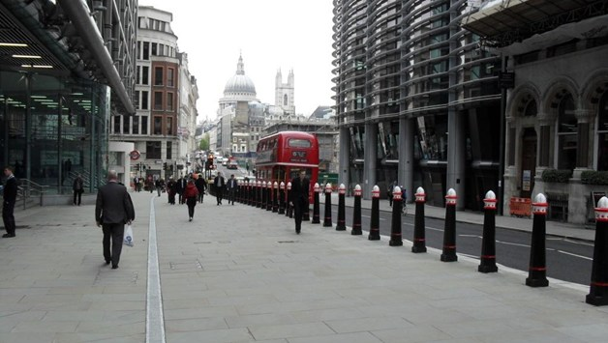
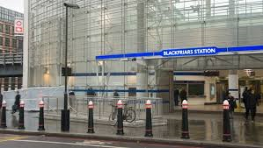
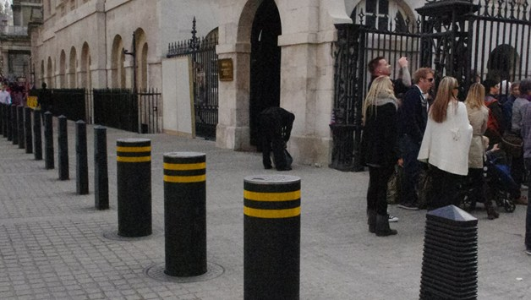
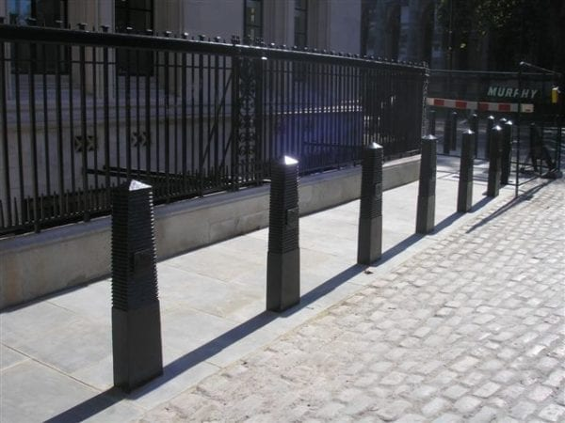

Slide 17
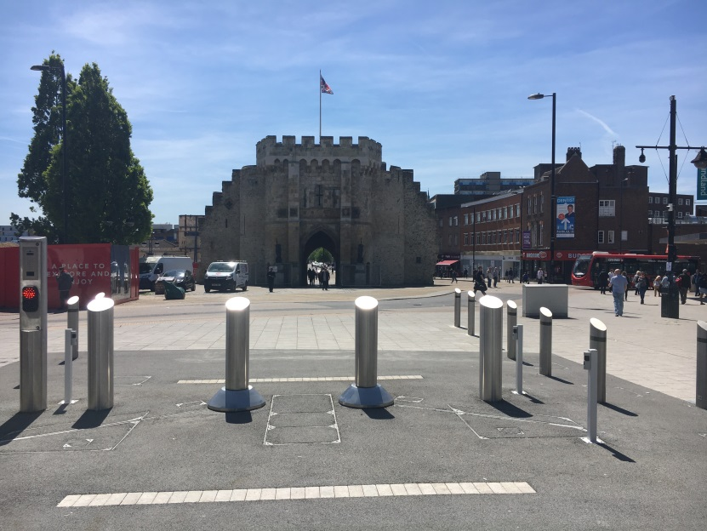
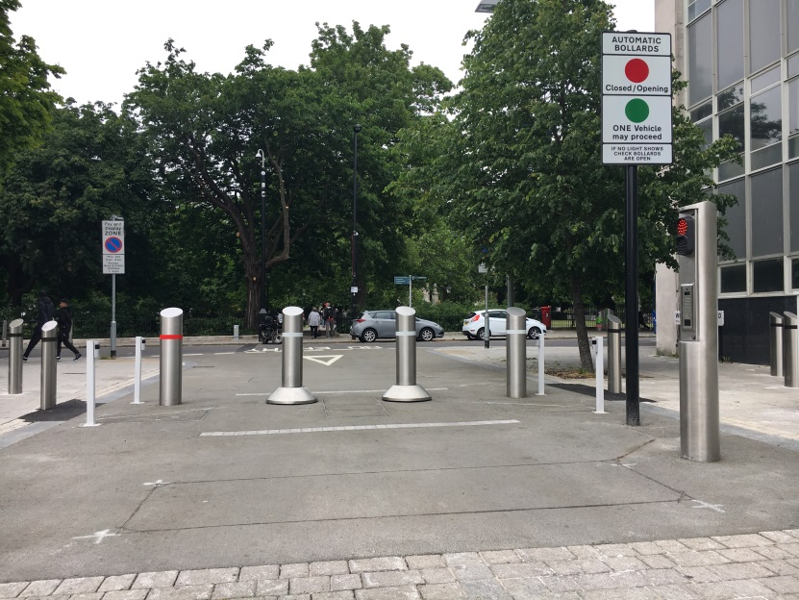
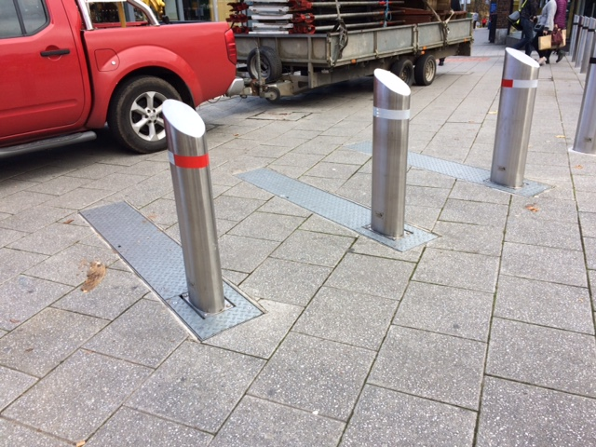
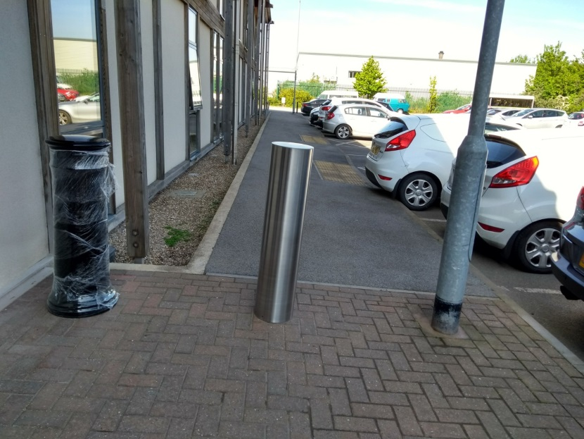

Slide 19
Heald HT2 – Crash Test Video

Slide 20
Next Steps
Public Consultation due to commence February 2020
TRO subject to minimum 21 day advertisement period following public consultation
Pre-Application – Listed Building/Ancient Monument Consent
Continued engagement with Trusted Partners, including police, fire and ambulance

Slide 21
Any Questions?

