Slide 1
Bath City Centre Security
Presentation to IEAG
Tuesday 28 January 2020

Slide 2
Welcome and Introductions
National and Local Counter-Terrorism Context
NaCTSO Counter-Terrorism Security Survey – Bath 2016
Proposed Security Measures – HVM
Since 2016 to date
Proposed Scheme for Bath
Programme Timeline
Questions and Feedback
Future Engagement

Slide 3
Threat Levels
Critical
An attack is highly likely in the near future
Severe
An attack is highly likely
Substantial
An attack is likely
Moderate
An attack is possible but not likely
Low
An attack is highly unlikely
What is the current national threat level in the UK?
Notes:
***COMPULSORY SLIDE***
KEY POINTS:
The UK threat level structure was revised in July 2019.
There are no longer separate threat levels for “international terrorism” and Northern Ireland-related terrorism in the UK. There is now just one National Threat level which reflects all aspects of terrorism regardless of the motivation, including Islamist, Northern Ireland, left-wing and right-wing terrorism.
The threat from Northern Ireland related terrorism in Northern Ireland will remain separate from the national threat level.
The threat level was last raised to CRITICAL in 2017 - Manchester Arena in May & Parsons Green in September.
The previous 2 occasions that the threat was raised to CRITICAL were The Tiger Tiger nightclub/Glasgow Airport attacks in 2007 & following the arrest of 21 people in relation to the airliner bomb plot in 2006.
Discuss with your audience why the threat level will be raised to Critical; i.e. manhunt or intelligence to suggest an imminent attack.
The threat level has sat at a minimum of severe since August 2014.

Slide 4
National and Local Context
What is a hostile vehicle?
Parked: A Vehicle-Borne Improvised Explosive Device (VBIED) may be parked close to a vulnerable location
Encroachment: A hostile vehicle may be able to exploit gaps in perimeter protection, or tailgate a legitimate vehicle through a single layer Vehicle Access Control Point (VACP)
Penetrative: A vehicle may be used to weaken and/or breach a building or physical perimeter or obstruction
Deception: A hostile vehicle may be modified to replicate a legitimate vehicle (ie“Trojan” vehicle), or the occupants of a vehicle may use pretence to gain access through a VACP
Duress: A guard could be forced to grant hostile vehicle access, or a legitimate driver could be forced to take an Improvised Explosive Device (IED) within their vehicle in to a vulnerable location.
Vehicle as a weapon: A vehicle being used with hostile intent to harm people and/or damage property.

Slide 5
National and Local Context
Hostile Vehicle Mitigations (HVM)
Restricted Access & Management – Through combination of strategically placed HVM active and static bollards.
Barriers as part of the public realm – Consideration of HVM street furniture in combination with static HVM bollards

Slide 6
Bath City Centre Security
National Counter-Terrorism Security Office (NaCTSO) Bath City Centre Report 2016
International Tourist Destination
World Heritage Status
Crowded Spaces
Temporary Events security

Slide 7
Project Update since 2016
Temporary HVM for Bath Christmas Market
Retained concrete blocks in key areas of the City
Temporary HVM for other events
SouthGate permanent solution
Training and Awareness Raising – Senior Leadership Team and customer-facing staff and partners
Political support and funding to scope project
Capital and Revenue Budget for 2020/21, 2021/22
Evidence Gathering & Scheme Design (on-going)
CCTV coverage review – central core

Slide 8
Proposed Scheme for Bath City Centre

Slide 9
Central Core

Slide 10
Central Core
Consultation to inform final scheme
Identified Crowded Spaces as defined in the NaCTSO Report
24/7 Permanent Access Restriction, with limited access during non-peak hours – to be determined (currently 1800 hours to 1000 hours, however, due to security we envisage this being shorter)
Managed by Bath & North East Somerset Council
Reduction in vehicles permitted access
Some streets may be considered for permanent closure
Emergency vehicle access 24/7 (when responding on a blue light)
Protocols and mitigations being work through
Will require a legal traffic regulation order to be advertised post consultation

Slide 11
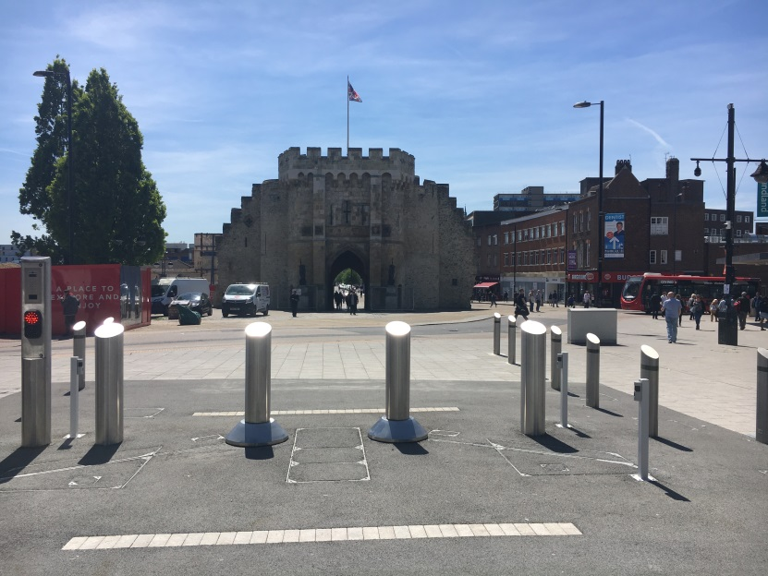
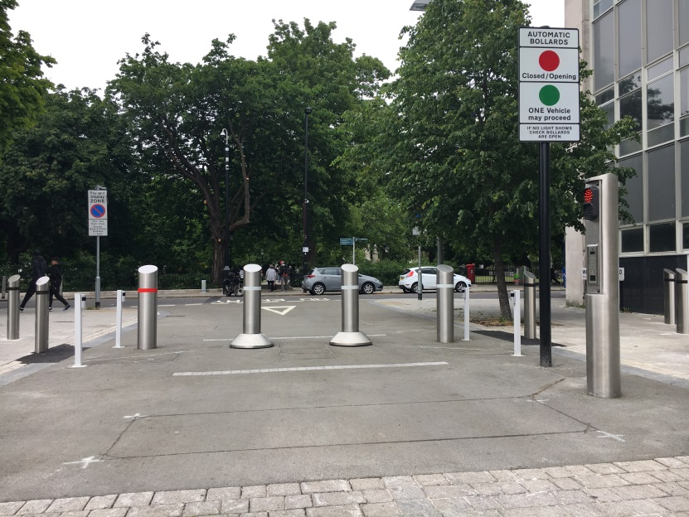
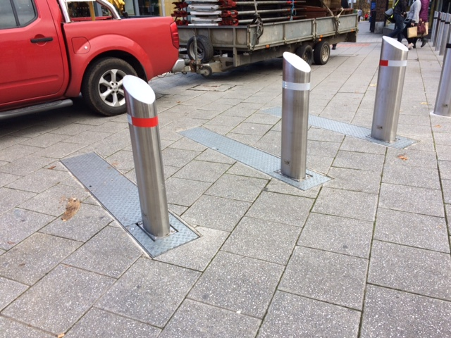
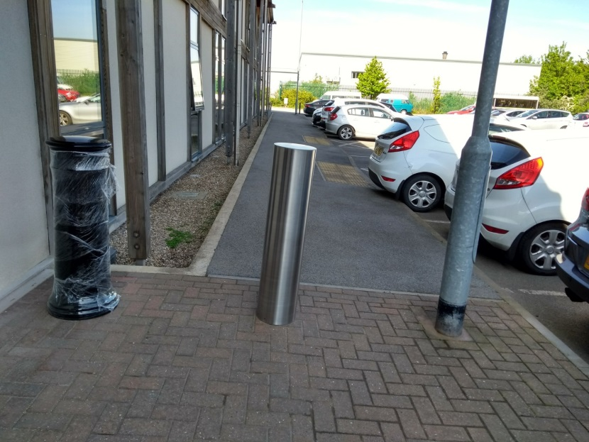

Slide 12
Heald HT2 – Crash Test Video

Slide 13
Impacts & Mitigations
Various user groups could be impacts by the proposals
We have already identified a number of these through consultation with internal B&NES teams and will shortly undertaking further consultation
Opportunity to raise particular concerns regarding access needs
Mitigations could include the on-going use of Shopmobility service

Slide 14
Next Steps
Public Consultation due to commence February 2020
Traffic Regulation Order advertisement period following public consultation
Continued engagement with stakeholders, including police, fire and ambulance to help shape the final scheme

Slide 15
Any Questions?

